Slide 1


HOW TO IN DOCKER
EK TECH SOFTWARE SOLUTION, FROM HERE LIFE AND CAREERS CHANGE ARE POSSIBLE

Slide 2
Docker commands
Important docker commands

Slide 3
Docker images

Slide 4
What is a Docker image
A Docker image is a read-only template that contains a set of instructions for creating a container that can run on the Docker platform. It provides a convenient way to package up applications and preconfigured server environments, which you can use for your own private use or share publicly with other Docker users. Docker images are also the starting point for anyone using Docker for the first time.

Slide 5
Pull an image to your VM
To Pull an image means to download an image from dockerhub to your VM. When the command is applied docker perform the following action(s)
1- check if the image exist locally first
2- if the image does not exist locally docker will pull (download) that image from dockerhub if the image exit
$ docker pull [repository]:[image tag]
1- docker called the docker client
2- pull action to perform which means in other word download
3- ubuntu is the repository
4- latest is the image tag to pull
2
3
1
4
$ docker pull ubuntu
or
$ docker pull ubuntu:latest

Slide 6
Pull an image to your VM
To Pull an image means to download that image from dockerhub to your VM. When the command is applied docker perform the following action(s)
1- check if the image exist locally first
2- if the image does not exist locally docker will pull (download) that image from dockerhub if the image exit
1- docker called the docker client
2- pull action to perform which means in other word download
3- ubuntu is the repository
4- 22.10, 20.04 are the image tags to pull
2
3
4
1
$ docker pull ubuntu:22.10
$ docker pull ubuntu:20.04

Slide 7
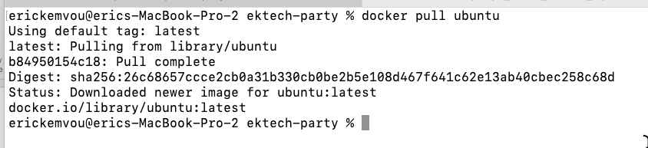
Pull an image to your VM
PS: If you don’t specify the image tag to download docker will pull the latest image tag
$ docker pull ubuntu --------- docker will pull ubuntu:latest
$ docker pull centos --------- docker will pull centos:latest

Slide 8
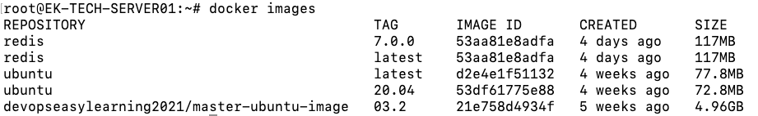
list all existing images.
To list all existing images means to display all images that are currently located in your VM
$ docker images
1- docker called the docker client
2- images action to perform which means in other words display all images
1
2
$ docker images

Slide 9
list all existing images
PS: the command
is
$ docker images.
and NOT
$ docker image
1- docker called the docker client
2- images action to perform which means in other words display all images
1
2
$ docker images

Slide 10
Rename an image
$ docker tag [source image]:[tag] [destination image]:[tag]
docker will make a copy on the source image with the name given on the destinantion image
Destination image and tag
Source image and tag
$ docker tag nginx:latest eric:001

Slide 11
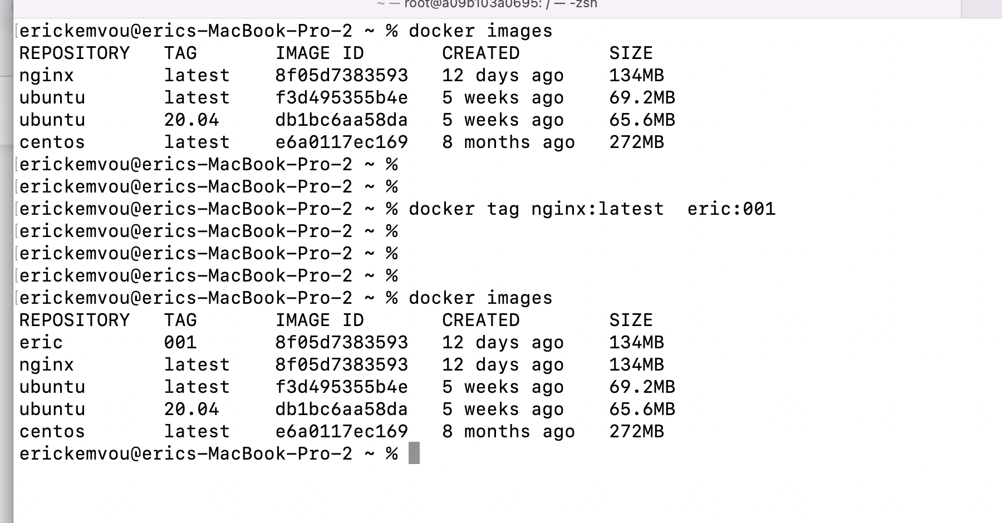
Rename an image
Here is the new image

Slide 12
Remove an existing image(s)
To Remove an image or images means that docker will perform the following actions
1- check if the image exist
2- if the image exist docker will remove it from your virtual machine
$ docker rmi -f [repository]:[image tag]
1- docker called the docker client
2- action to perform
3- repository from which the image will be removed
4- specific image tag to remove
$ docker rmi -f centos
The above command will remove the latest centos image
We saw earlier that when you don’t specify the image tag docker use the latest image
You can remove multiple images at the same time
$ docker rmi centos
The above command will remove the latest centos image
We saw earlier that when you don’t specify the image docker use the latest image
2
3
1
4
$ docker rmi -f ubuntu
or
$ docker rmi –f ubuntu:latest
$ docker rmi -f ubuntu:20.04

Slide 13

Delete or remove ALL Images not being used
$ docker images prune -a –f
Docker will remove ALL images not being used
PS: This command is very dangerous make sure you know what you are doing before you run such command

Slide 14
Delete or remove ALL Images at the same time
$ docker rmi –f $(docker images –aq)
Docker will remove ALL images that are not being used
PS: This command is very dangerous make sure you know what you are doing before you run such command

Slide 15
Remove existing image(s) with force
To Remove an image or images means that docker will perform the following actions
1- check if the image exist
2- if the image exist docker will remove it from your virtual machine
$ docker rmi –f [repository]:[image tag]
1- docker called the docker client
2- action to perform
3- repository from which the image will be removed
4- specific image tag to remove
-f means forcedly remove the image even if it is been use by a container
2
3
1
4
$ docker rmi -f ubuntu
or
$ docker rmi -f ubuntu:latest
$ docker rmi -f ubuntu:20.04

Slide 16
Remove multiple image(s)
To Remove an image or images means that docker will perform the following actions
1- check if the image exist
2- if the image exist docker will remove it from your virtual machine
$ docker rmi -f [repository]:[image tag] [repository]:[image tag] …………………………. [repository]:[image tag]
$ docker rmi -f ubuntu:20.04 centos redis:7.0.0 node postgres mysql

Slide 17
Docker containers

Slide 18
What is a docker container ?
A container is a standard unit of software that packages up code and all its dependencies so the application runs quickly and reliably from one computing environment to another. A Docker container image is a lightweight, standalone, executable package of software that includes everything needed to run an application: code, runtime, system tools, system libraries and settings.

Slide 19
Run containers in interactive mode
When performing the docker run run command the following will happened
1- docker will pull the image if it does not exist locally
2- start a new container with the requested image
3- log you inside the container
$ docker run -it [ repository]:[image tag] [command]
1- docker called the docker client
2- action to perform -it means interactive terminal in order words take me inside the container and give me a terminal I can interact or run commands
3- repository from which the image will be removed
4- specific image tag to use
5 bash or sh is the first command to run when the container start
2
3
4
5
1
$ docker run -it ubuntu:20.04 bash
$ docker run -it ubuntu:20.04 sh

Slide 20
Run a Container Interactively Docker allows you to run a container in interactive mode. This means you can execute commands inside the container while it is still running. By using the container interactively, you can access a command prompt inside the running container.

Slide 21
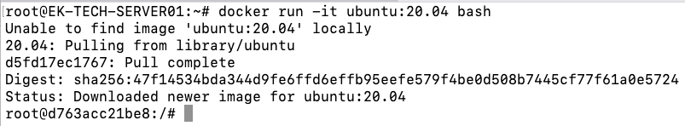
Run containers in interactive mode
Command to run
it notices the image does not exist locally
Pulling the image
At this point you are inside the container
Container id
The user inside the container, by default the user is always root

Slide 22
Run containers in interactive mode
Command to run
it notices the image does not exist locally
Pulling the image
At this point you are inside the container
Container id
The user inside the container, by default the user is always root

Slide 23
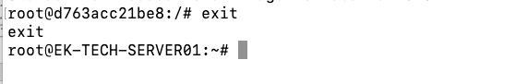
Run containers in interactive mode: exit a container
Command
Notice that you are back inside your virtual machine

Slide 24
Run containers in interactive mode with container name assigned
1- docker run called the docker client
2- action to perform -it means interactive terminal in order words take me inside the container and give me a terminal I can interact or run commands
3- --name the argument telling docker we want to specified the container name
4- eric the name of the container it cans be any name even your own name but must be single name only
5- repository from which the image will be removed
6- specific image tag to use
7- bash or sh is the first command to run when the container start
$ docker run –it –name [specify a single name] [repository]:[image tag] [command]
4
5
6
2
3
7
1
$ docker run –it --name eric ubuntu:20.04 bash
$ docker run -it n --name eric ubuntu:20.04 sh

Slide 25
Run containers in interactive mode and attach a volume
$ docker run –it –v [volume locate in your VM]:[volume located inside the container] [repository]:[image tag] [command]
Docker will create all volumes if they do not exist with the name specified
If you want to use the current directory located in your VM as volume use ”$PWD”
1- docker run called the docker client
2- action to perform -it means interactive terminal in order words take me inside the container and give me a terminal I can interact or run commands
3- -v the argument telling docker we want to attach a volume locate inside our VM inside the container
4- $PWD telling docker to use our current directory as volume
5- /vol volume locate inside the container
6- repository from which the image will be removed
7- specific image tag to use
7- bash or sh is the first command to run when the container start
4
5
6
2
3
7
1
8
$ docker run -it -v $PWD:/vol ubuntu:20.04 bash
$ docker run -it -v /vol:/vol ubuntu:20.04 bash
PS: you can mount or attach multiple volumes at the same time

Slide 26
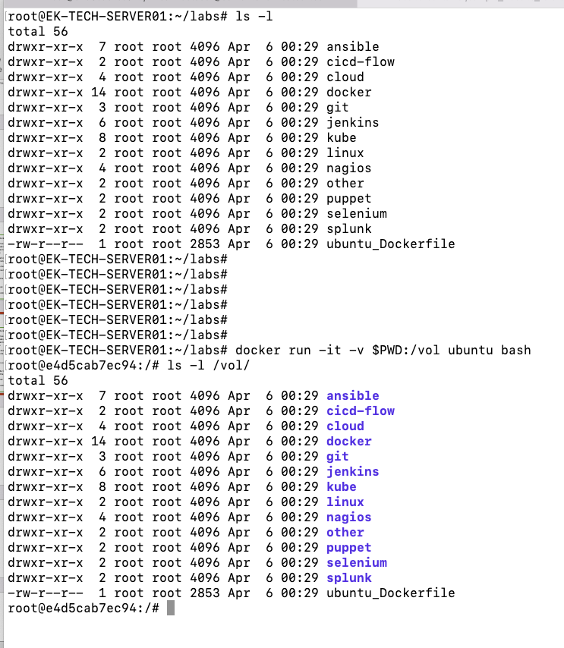
I am running this command on my VM
output
This command will create a container and attach my current directory as a volume inside the container located at /vol
Let us see what is inside /vol inside the container
Output same as above
the volume in docker is very important because it allows you to mount files and directories from your local VM to the container and if any of these directories or files are modified either from your VM or inside the container they will be reflect on both sides (container and VM)

Slide 27
Run containers in interactive mode and create and environment variable
$ docker run –it –e [key]=[value] [repository]:[image tag] [command]
Docker will create the environment variable specified if it does not exist
1- -e telling docker you want to create an environment variable
2 and 3 create the environment variable inside the container
2
3
1
$ docker run -it -e COUNT=50 ubuntu:20.04 bash
$ docker run -it -e DEVOPS=money -e A=jobs ubuntu:20.04 bash
PS: you can create multiple env variable at the same time

Slide 28
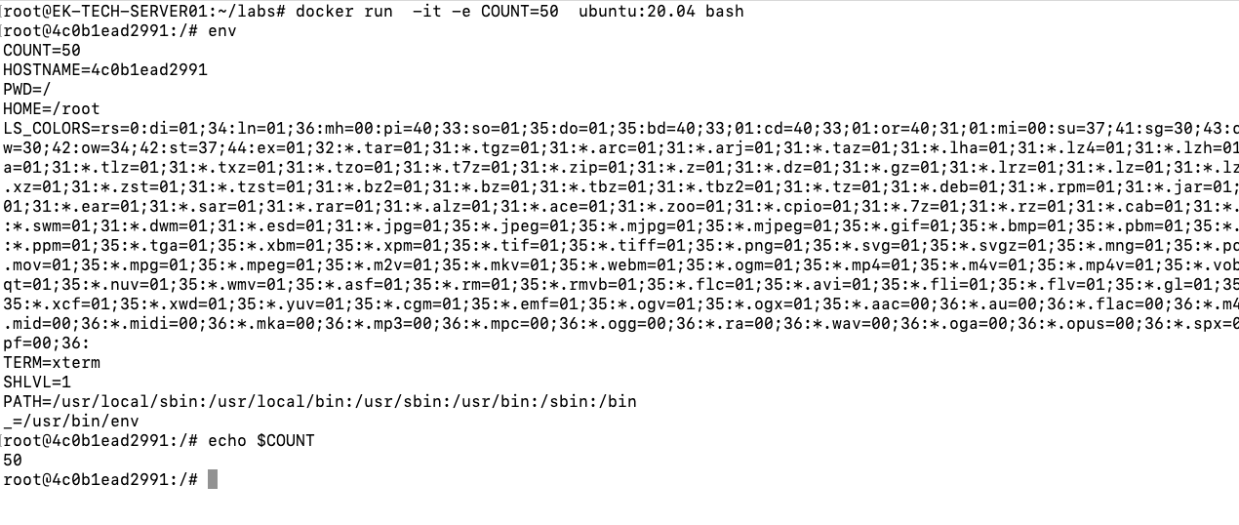

Launch a container with env variable
Let us run the command env inside the container
As you can see the variable we specified at the run time is there
Let us print that variable using the echo command
output

Slide 29
Run containers in interactive mode and set a working directory
$ docker run –it –w [specify a directory inside the container] [repository]:[image tag] [command]
Docker start the container and set your current working directory to the the directory you specified
PS: The directory must exist first docker will NOT create it
1- -w telling docker you want set working directory
2 /home will be the current directory when the container start
2
1
$ docker run -it -w /home ubuntu:20.04 bash
$ docker run -it -w /opt ubuntu:20.04 bash
PS: you can only specify one working directory

Slide 30
Notice here I did not specified the working directory and docker set my home directory to the top level directory (/) by default
Notice here my current working directory is ”/home” which is the one I specified on the command

Slide 31
Assigning a Port Mapping to a Docker Container
Port mapping is used to access the services running inside a Docker container. We open a host port to give us access to a corresponding open port inside the Docker container. Then, all the requests that are made to the host port can be redirected into the Docker container.
Port mapping makes the processes inside the container available from the outside.
While running a new Docker container, we can assign the port mapping in the docker run command using the -p option

Slide 32
Run containers in interactive mode and open a port
$ docker run –it -p [port on your VM]=[port inside the container ] [repository]:[image tag] [command]
Docker will map a port from your VM to a port inside the container
-p telling docker you want to map to a port inside a container
87 port on your VM that you want to map with another port inside the container
80 port exposed inside the container that you want to map with another port on your virtual machine
3
2
1
$ docker run -it -p 87:80 nginx bash
$ docker run -it -p 50:80 -p 89:8080 ubuntu:20.04 bash
PS: you can open multiple ports at the same time

Slide 33
Using multiple arguments on interactive mode
All arguments can be used at once under a single command in docker

Slide 34
$ docker run -it --name devops -w /home -e DEVOPS=money -v $PWD:/vol -p 85:81 nginx bash

Slide 35
Docker detached mode (-d) Detached mode, shown by the option --detach or -d, means that a Docker container runs in the background of your terminal. It does not receive input or display output.

Slide 36
In other words detach mode means that docker will not log or or take you inside the container when it start
$ docker run -d --name devops nginx bash
$ docker run -d -e DEVOPS=money nginx bash
$ docker run -d -v $PWD:/vol nginx bash
$ docker run -d -p 85:81 nginx bash
$ docker run -d --name devops -w /home -e DEVOPS=money -v $PWD:/vol -p 85:81 nginx bash

Slide 37
$ docker run -d --name devops -w /home -e DEVOPS=money -v $PWD:/vol -p 85:81 nginx bash

Slide 38
command
The container was created and there is the container ID
Notice that I am still inside my VM
As we can all see the –d flag will create the container but will not log or take you inside the container

Slide 39
Docker interactive detached mode (-itd) Detached mode, shown by the option --detach or -itd, means that a Docker container runs in the background of your terminal but with an attache terminal which we can ssh inside the container late, but It does not receive input or display output.

Slide 40
In other words interactive detach mode means that docker will not log or or take you inside the container when it start, but later on you can ssh inside and have a shell to work on
$ docker run -itd --name devops nginx bash
$ docker run -itd -e DEVOPS=money nginx bash
$ docker run -itd -v $PWD:/vol nginx bash
$ docker run -itd -p 85:81 nginx bash
$ docker run -itd --name devops -w /home -e DEVOPS=money -v $PWD:/vol -p 85:81 nginx bash

Slide 41
Using multiple arguments on interactive detach mode
All arguments can be used at once under a single command in docker

Slide 42
$ docker run -itd --name devops -w /home -e DEVOPS=money -v $PWD:/vol -p 85:81 nginx bash

Slide 43
command
The container was created and there is the container ID
Notice that I am still inside my VM
As we can all see the –itd flag will create the container but will not log or take you inside the container as well

Slide 44
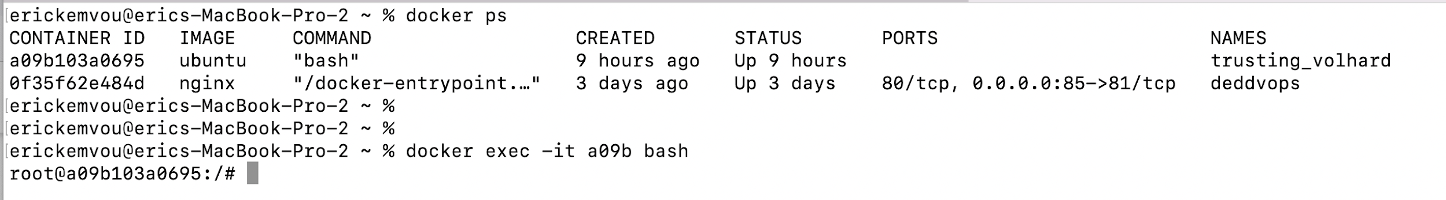
Logging into a running containers
$ docker exec –it [container name or container ID] bash
Or
$ docker exec –it [container name or container ID] sh
Docker take you inside the running container
Let us list all running containers first
command
I am now inside the container
To leave a container once you are inside just type the command $exit

Slide 45
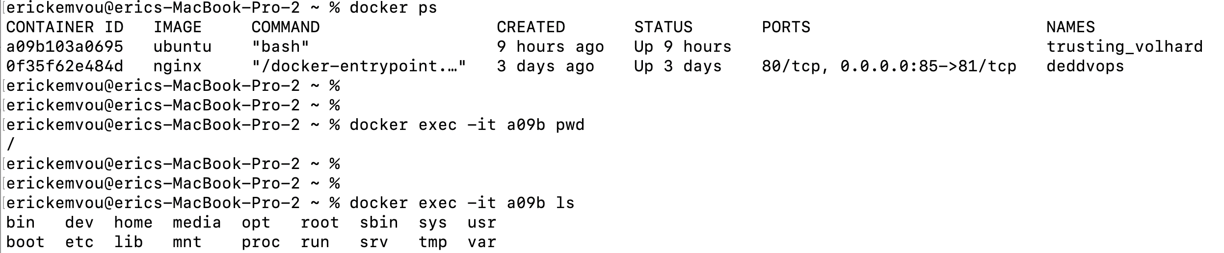
How to run a command in a running container without login inside
$ docker exec –it [container name or container ID] [command]
Docker will NOT take you inside the running container but will run the indicated command for you

Slide 46
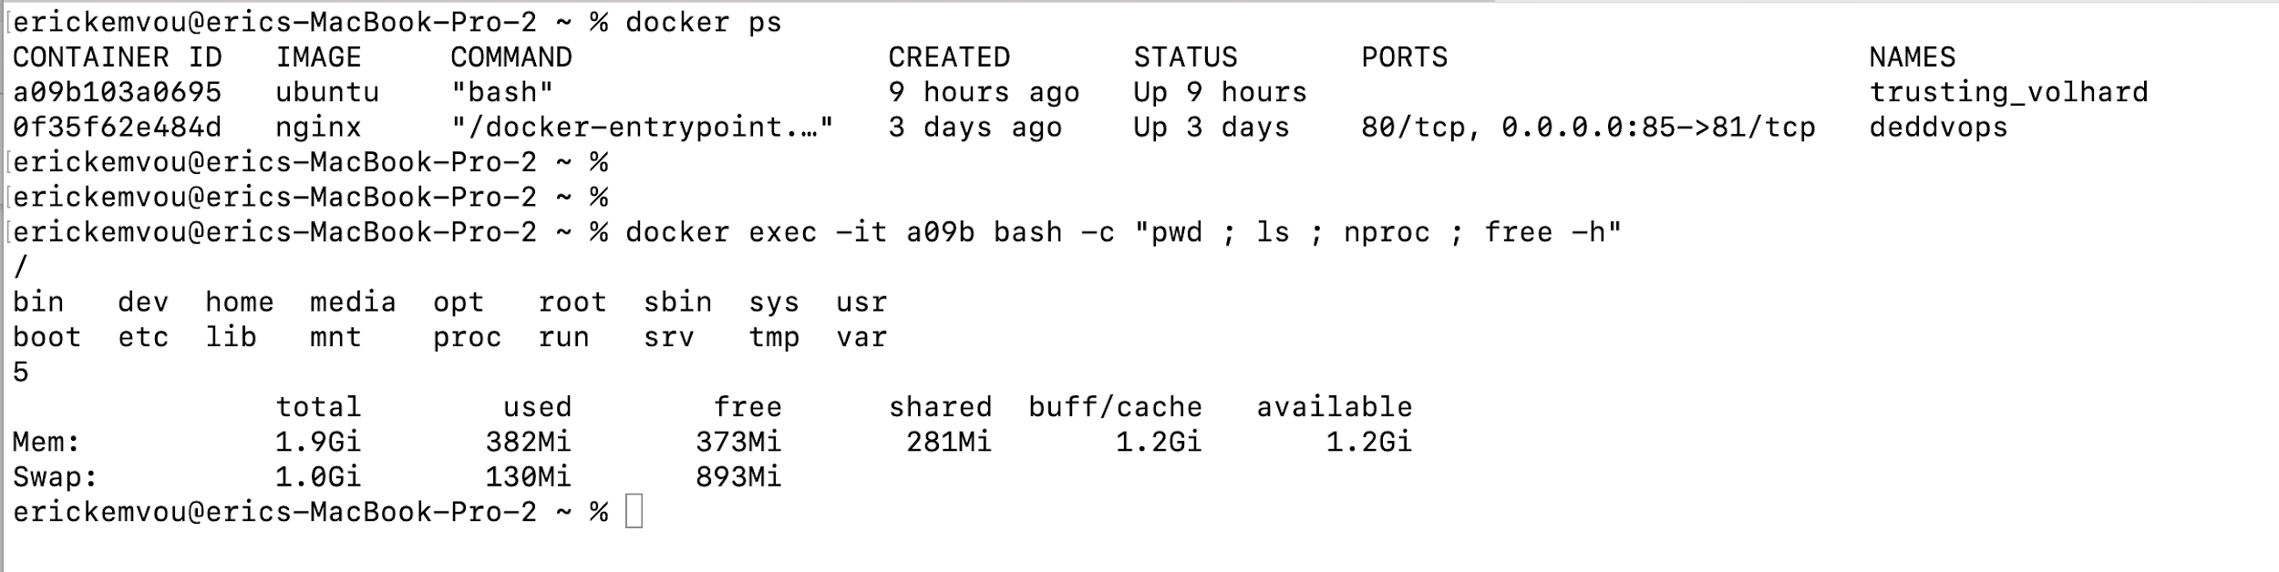
How to run multiple commands in a running container without login inside
$ docker exec –it [container name or container ID] bash –c “ [command 1] ; [command 2] …….. ; [command n]
Docker will NOT take you inside the running container but will run the indicated commands for you
Notice that commands are separated by a semi colon (;)

Slide 47
Now that we have learn how to create containers let us move to the next step

Slide 48
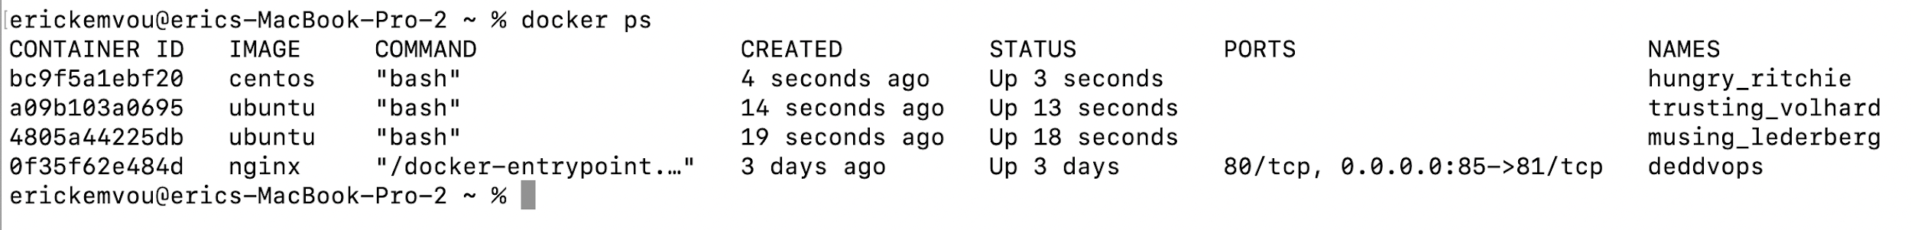
List all running containers
$ docker ps
Docker display all running containers ONLY
Notice that all container status are “UP” meaning they are in running state

Slide 49
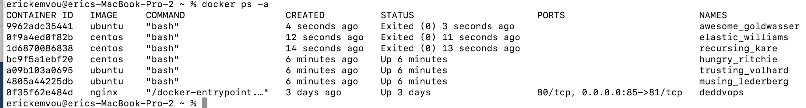
List all containers (Running and exited containers)
$ docker ps -a
Docker display all containers
Notice that all container status are “UP or Exited” meaning “docker ps –a” will display all

Slide 50
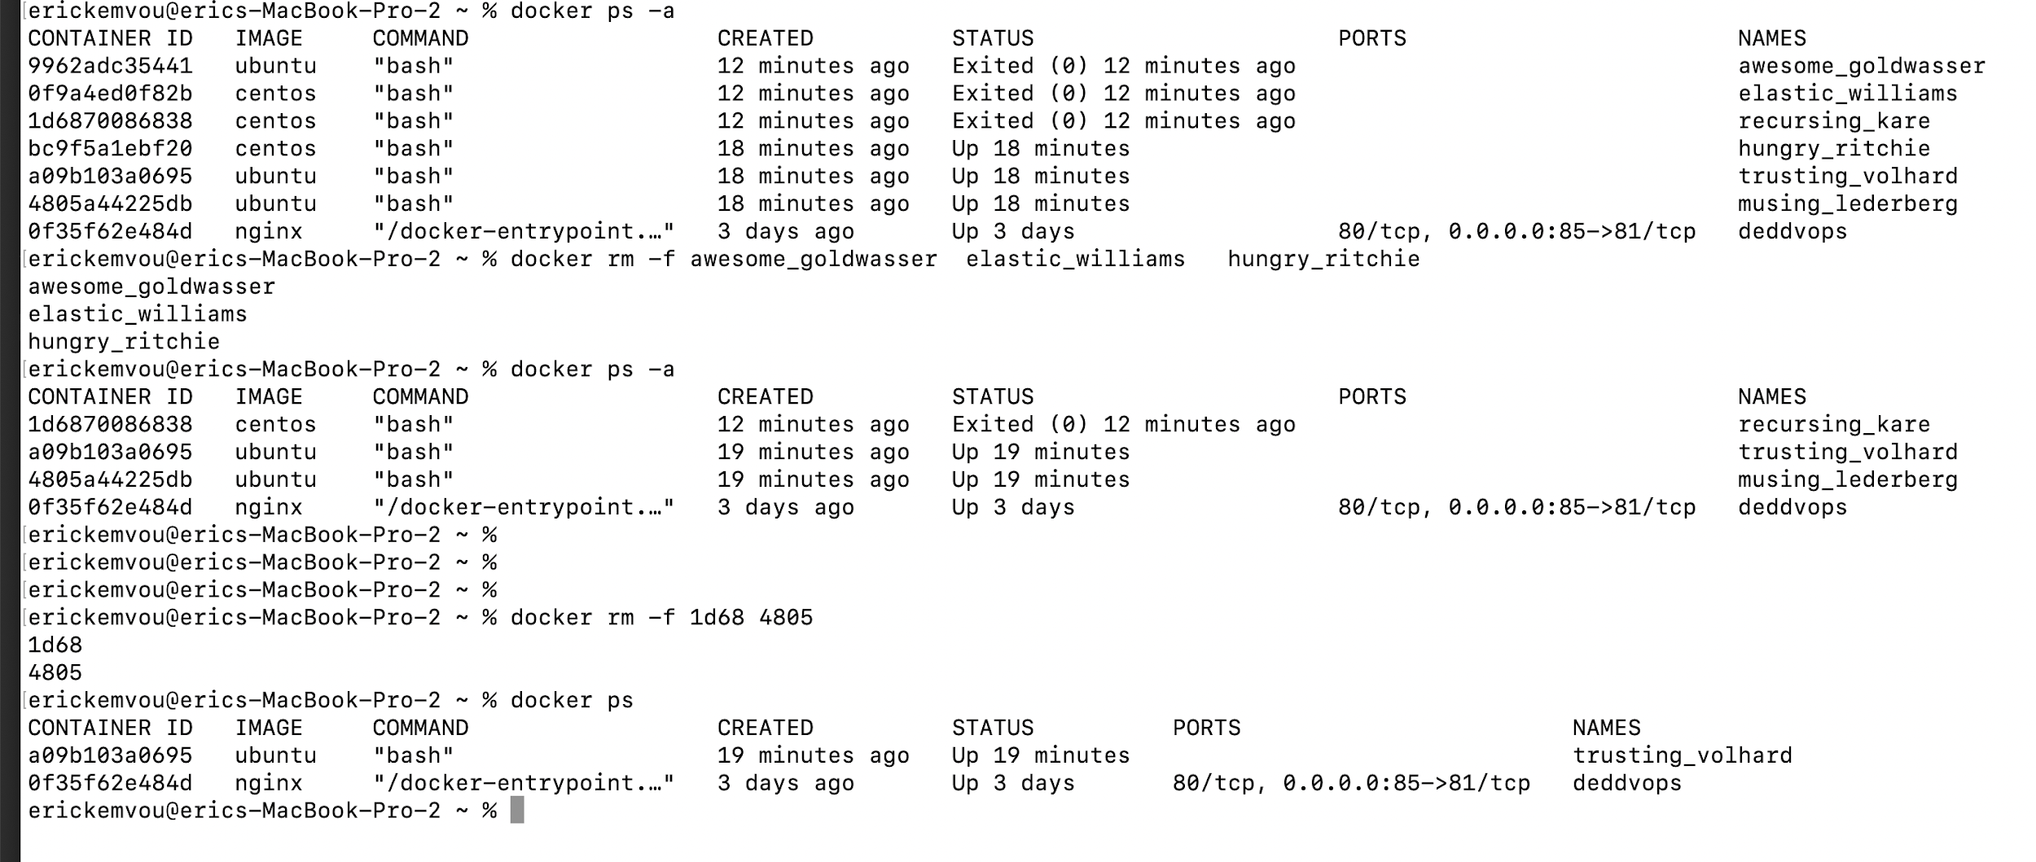
Delete or remove containers
$ docker rm –f [ container name] …………….. [ container name]
Or
$ docker rm –f [ container ID] …………….. [ container ID]
Docker will remove indicated containers
Notice that I was able to remove containers by names or ID
If you want to use containers ID you can use only the first few digit of the container ID
$docker rm –f 415ddcfg415
Will work same as
$docker rm 415

Slide 51
Stop running container(s)
$ docker stop [ container name] …………….. [ container name]
$ docker stop [ container ID] …………….. [ container ID]
Docker will stop indicated containers
To stop a container, use the docker stop command with either the container id or container name. We may stop a container if we want to change our docker run command.
$ docker stop f8c52bedeecc
$ docker stop f8c52bedeecc dgfbfhsb dhdd ddddd
$ docker stop ryann odilia

Slide 52
start stopped container(s)
$ docker start [ container name] …………….. [ container name]
$ docker start [ container ID] …………….. [ container ID]
Docker will start indicated containers
To start a container, use the docker start command with either the container id or container name.
$ docker start f8c52bedeecc
$ docker start f8c52bedeecc dgfbfhsb dhdd ddddd
$ docker start ryann odilia

Slide 53
restart stopped or running container(s)
$ docker start [ container name] …………….. [ container name]
$ docker start [ container ID] …………….. [ container ID]
Docker will restart indicated containers
To restart means, stop first then start after
We can restart a single or multiple containers
$ docker restart f8c52bedeecc
$ docker restart f8c52bedeecc dgfbfhsb dhdd ddddd
$ docker restart ryann odilia

Slide 54
Check the log of a container
$ docker logs [ container name]
$ docker logs [ container ID]
Docker will display the log of indicated container
This command is helpful to debug our Docker containers. It will fetch logs from a specified container..
$ docker logs f8c
$ docker logs ryann

Slide 55
Check the log of a container in real time
$ docker logs -f [ container name]
$ docker logs –f [ container ID]
Docker will display the log of indicated container in real time
This command is helpful to debug our Docker containers. It will fetch logs from a specified container..
$ docker logs -f f8c
$ docker logs -f ryann

Slide 56
Delete or remove ALL exited containers
$ docker container prune –f
Docker will remove ALL exited containers
PS: This command is very dangerous make sure you know what you are doing before you run such command

Slide 57
Delete or remove ALL containers
$ docker rm –f $(docker ps –aq)
Docker will remove ALL containers
PS: This command is very dangerous make sure you know what you are doing before you run such command

Slide 58
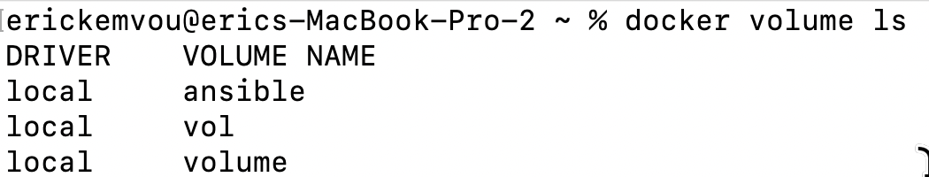
Create volumes , list all volumes
$ docker volume create [volume name]
Docker will create a volume with the name provided
To list all volume
$ docker volume ls
$ docker volume create vol
$ docker volume create ansible
$ docker volume create volumes

Slide 59
Where are docker volumes located
/var/lib/docker/volumes

Slide 60
Remove ALL volumes NOT being used
PS: This command is very dangerous make sure you know what you are doing before you run such command
$ docker volume prune –f
Docker will remove all volume that re not being used

Slide 61
Delete or remove all volumes
$ docker rm volume –f [volume name 1 ]…….. [volume name n ]
Docker will remove ALL volume
PS: This command is very dangerous make sure you know what you are doing before you run such command
$ docker rm volume –f vol ansible volumes

Slide 62
Delete all volumes, images, containers network not being used
$ docker system prune –f –a
Docker will remove all entities NOT being used
PS: This command is very dangerous make sure you know what you are doing before you run such command
$ docker system prune –f –a

Slide 63
Dockerhub
Navigate in dockerhub
www.https://hub.docker.com/

Slide 64
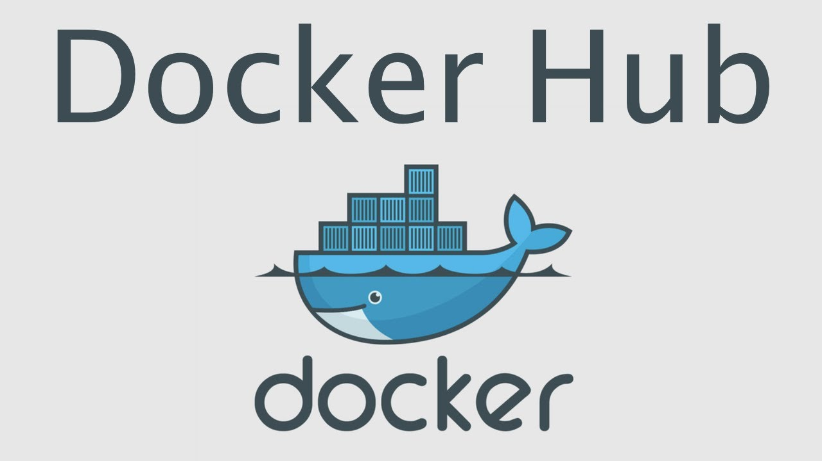
What is dockerhub ?
Docker Hub is a service provided by Docker for finding and sharing container images with your team.

Slide 65
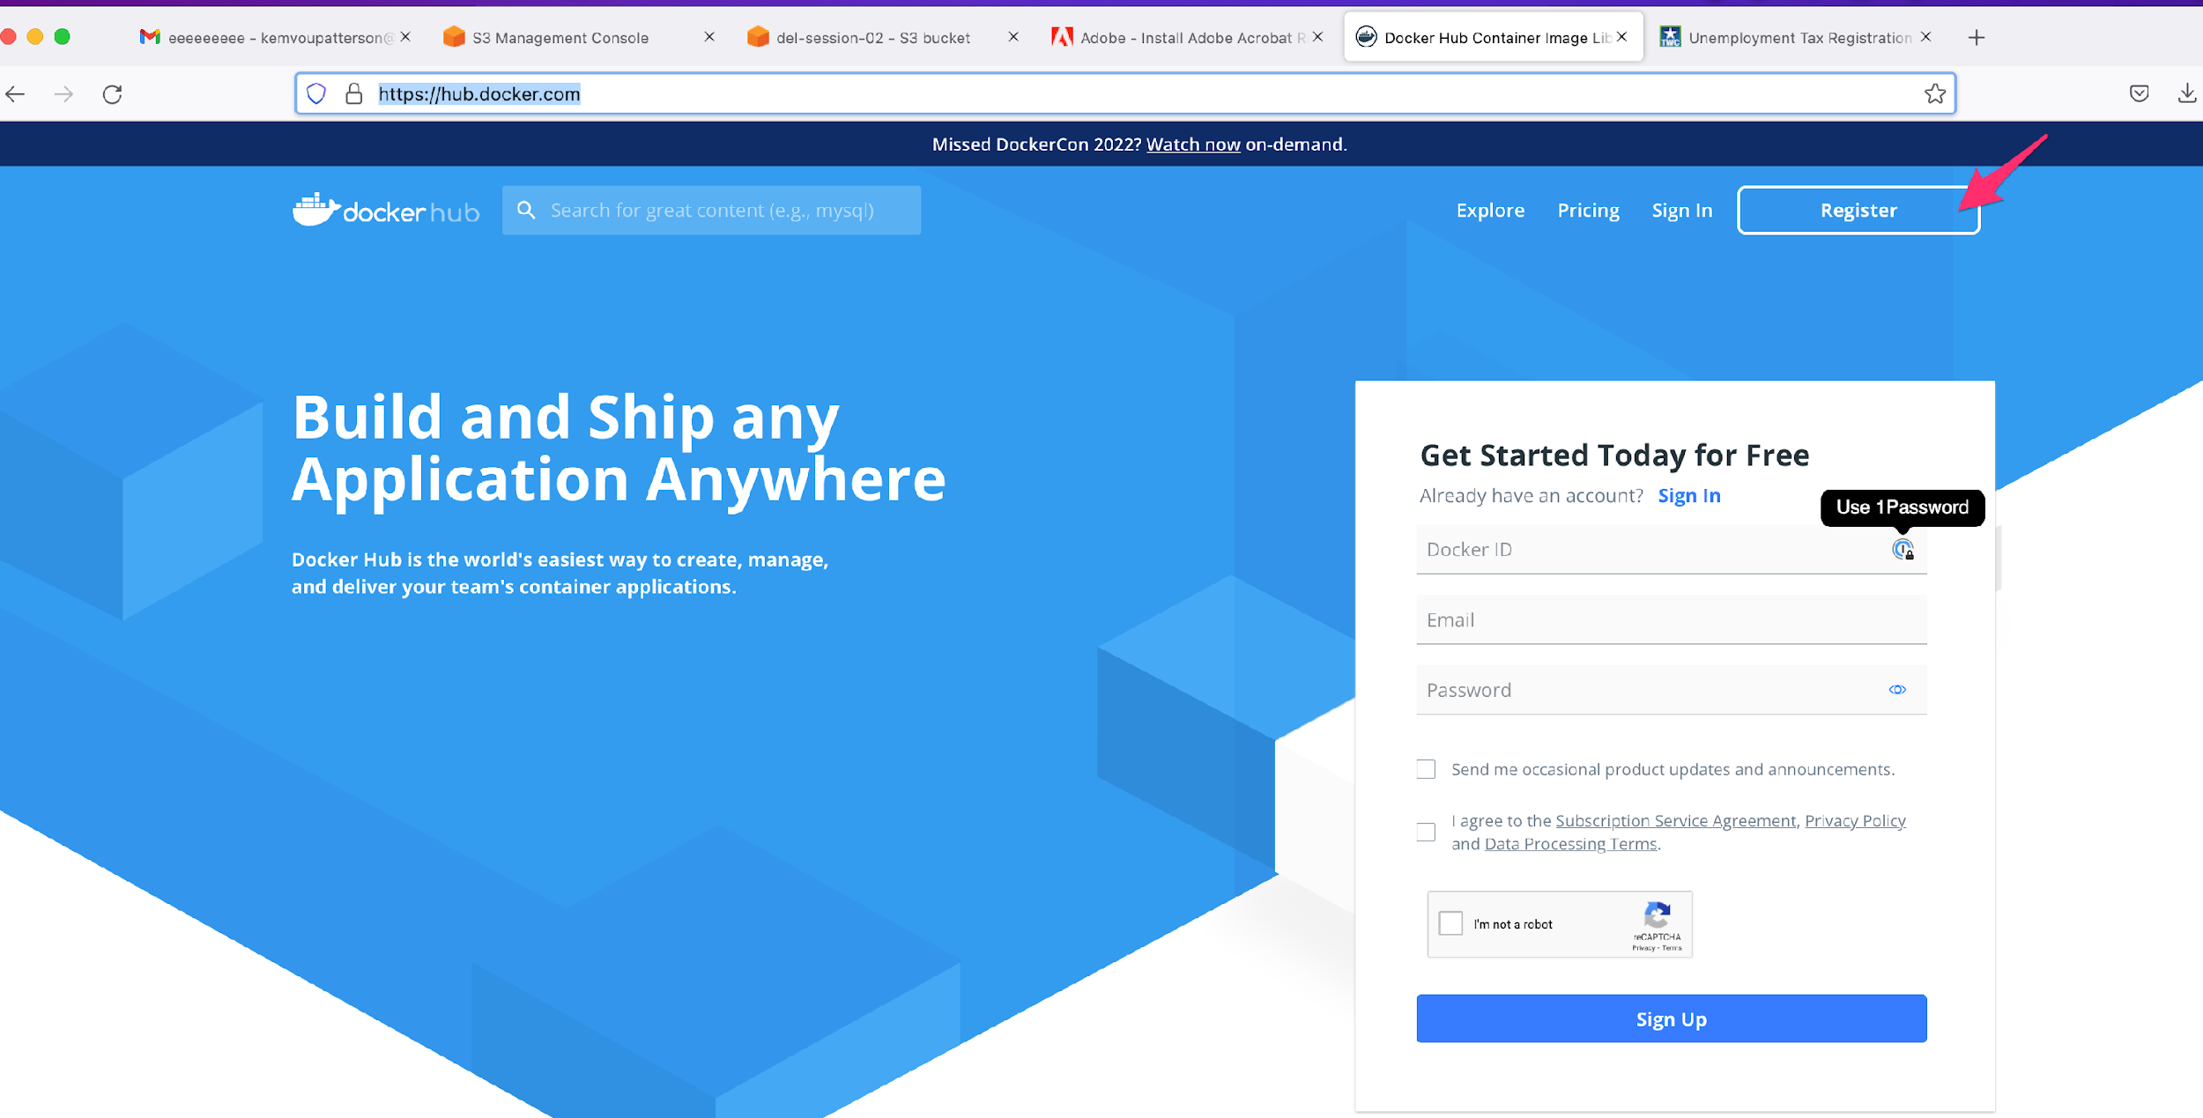
How to login register?
1- open https://hub.docker.com/
2- click on login and follow instructions
To open an account is free
But
EK TECH already have one for you

Slide 66

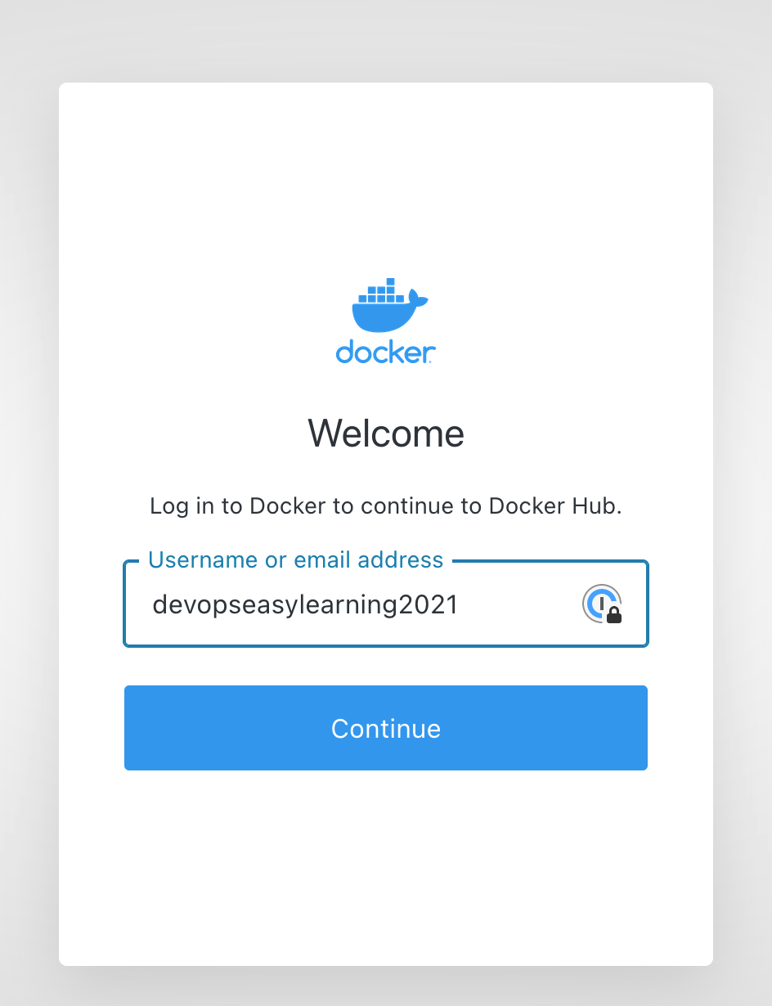
How to login EK TECH dockerhub account?
1- open https://hub.docker.com/
2- click on register and follow instructions
Username: devopseasylearning
Password: DevOps2021@

Slide 67
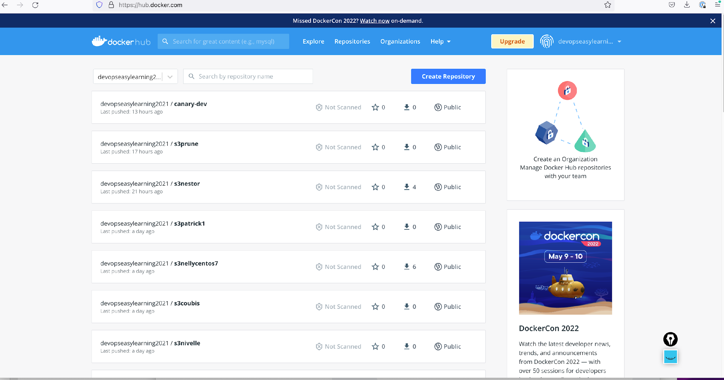
EK TECH dockerhub account main page

Slide 68
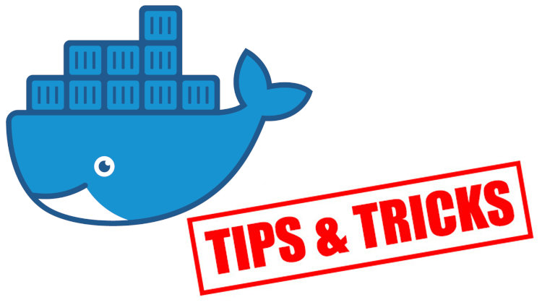
What is a docker repository ?
A Docker repository is where you can store 1 or more versions of a specific Docker image. An image can have 1 or more versions (tags).

Slide 69
What is a docker registry ?
A Docker registry is a storage and distribution system for named Docker images. The same image might have multiple different versions, identified by their tags.
A Docker registry is organized into Docker repositories , where a repository holds all the versions of a specific image. The registry allows Docker users to pull images locally, as well as push new images to the registry (given adequate access permissions when applicable).
By default, the Docker engine interacts with DockerHub , Docker’s public registry instance. However, it is possible to run on-premise the open-source Docker registry/distribution, as well as a commercially supported version called Docker Trusted Registry . There are other public registries available online.

Slide 70
Difference between a Registry, Repository and Image
A Docker repository is where you can store 1 or more versions of a specific Docker image. An image can have 1 or more versions (tags).
A Docker image can be compared to a git repo. A git repo can be hosted inside of a GitHub repository, but it could also be hosted on Gitlab, BitBucket or your own git repo hosting service. It could also sit on your development box and not be hosted anywhere.
The same goes for a Docker image. You can choose to not push it anywhere, but you could also push it to the Docker Hub which is both a public and private service for hosting Docker repositories. There are other third party repository hosting services too.
The thing to remember here is a Docker repository is a place for you to publish and access your Docker images. Just like GitHub is a place for you to publish and access your git repos.
It’s also worth pointing out that the Docker Hub and other third party repository hosting services are called “registries”. A registry stores a collection of repositories.
You could say a registry has many repositories and a repository has many different versions of the same image which are individually versioned with tags.

Slide 71
Difference between a Registry, Repository and Image in simple words
A registry is just like a warehouse that contains repository
A repository is a warehouse that contains images
Image are the main elements that docker store
Tags are different image version

Slide 72

Difference between a Registry, Repository and Image in simple words example
Imagine you rent a very big and huge warehouse to store cars
In that warehouse you store 15 containers with different sizes (A, B, C D,……..etc)
Inside those containers you have multiple cars (Toyota, Nissan, Honda……… etc)
Here the warehouse is your registry
Containers are your repository as you can see containers(repositories) were placed and kept inside the warehouse(registry) and inside each containers (repositories) we have multiple type of cars(tags)

Slide 73
What is docker official image
The Docker Official Images are images certified by docker that can be used by anyone

Slide 74
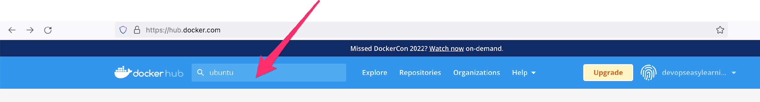
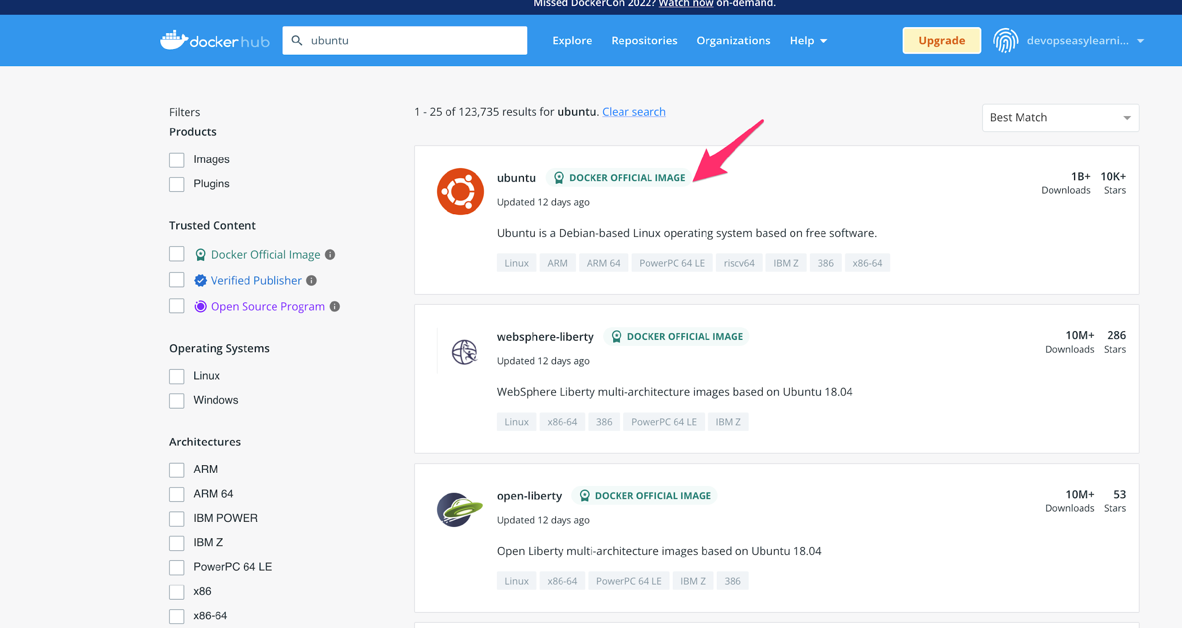
How to access official image
1- got to dockerhub ( you don’t need to login it is optional
2- on the search bar enter the image you would like to explore and press enter on your keyboard
3- click on the official image you would like to explore
Notice that all official image are stamped in green it means that if they are not stamped in green they are not official
Click anywhere here to explore the image

Slide 75
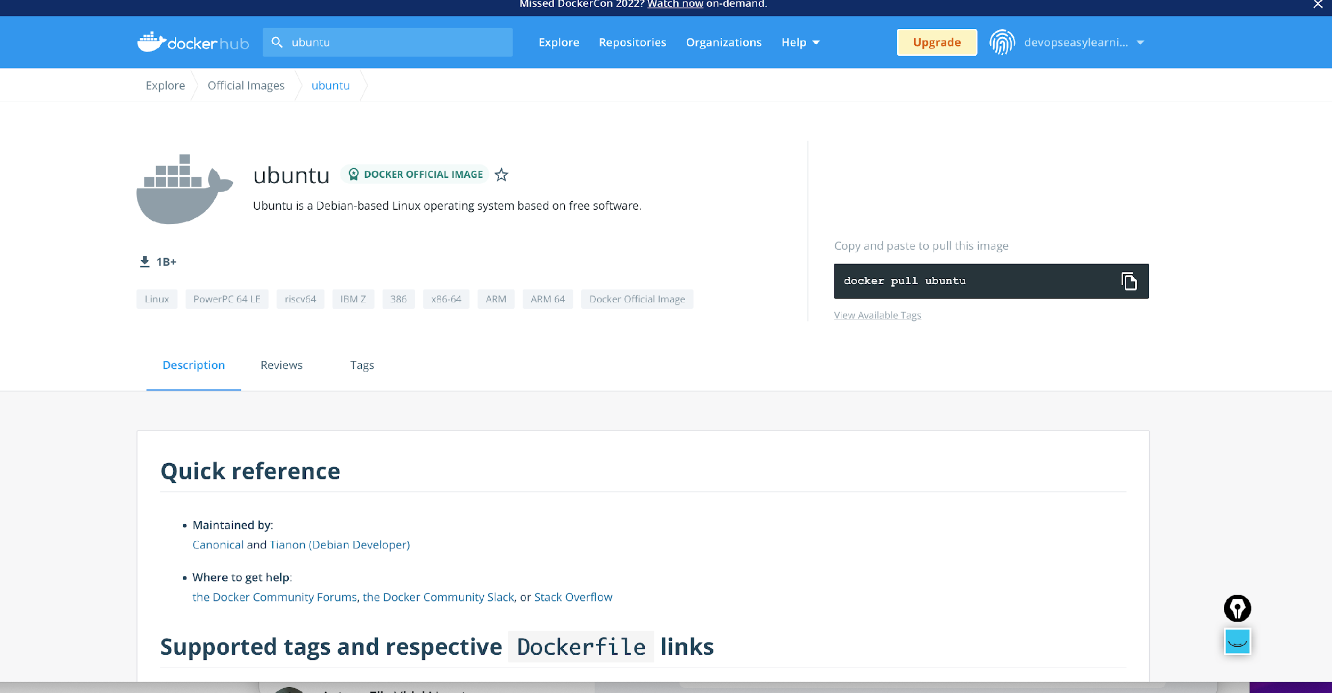
How to access official image
You can scroll down to read more about the image
A deep explanation will be provided in class

Slide 76
How to access official image
Copy the command to pull this image
Click here to see all tag

Slide 77
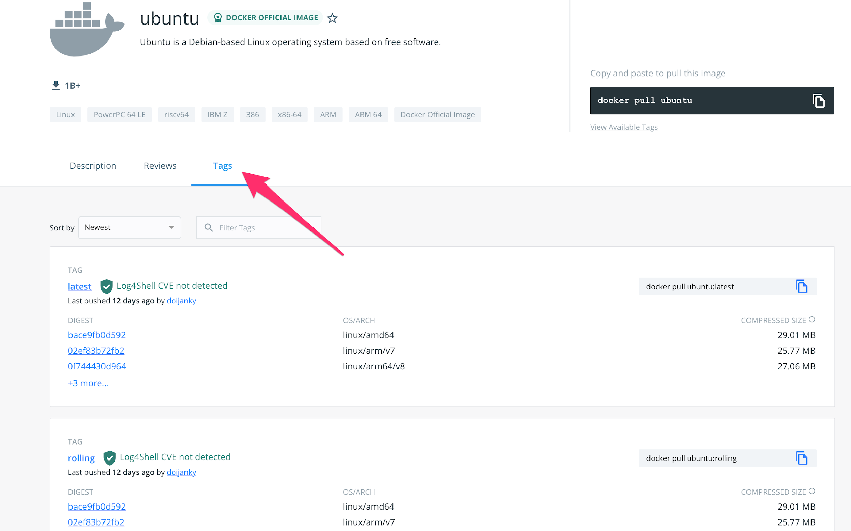
How to access official image
Click on any tag to explore it
We will explain this more in class
Scroll down to see more tags
Click here to see all tag

Slide 78

Shuuuuuuuuuut don’t tell anyone
The same way you explore official images you can explore non official image
Damn
So simple right ?

Slide 79
How to pull official image
$ docker pull [ official image name ]: [tag]
$ docker pull ubuntu:20.04
$ docker pull centos:centos7
Damn
So simple right ?

Slide 80
Dockerhub account structure (non official images)
1- repository name or dockerhub username
2- the slash tells docker that whatever before the slash is the repository name
3- the repository where docker should go pull the image
4- the : tells docker that the string (word) before the : is the repository name
5- is the image version to fetch or pull so a repository can have multiple image version
2
4
docker pull devopseasylearning2021/canary-dev:tagname
1
3
5

Slide 81
How to pull non official image
$ docker pull username or dockerhub account name ]/[repository name]: [tag]
$ docker push devopseasylearning2021/canary-dev:2268f
$ docker pull kemvoueric/redis-client:v1.1.0
$ docker pull nestio/s3cmd-sync:2.1-2

Slide 82
non official image vs official image
$ docker pull username or dockerhub account name ]/[repository name]: [tag]
$ docker push devopseasylearning2021/canary-dev:2268f
$ docker pull kemvoueric/redis-client:v1.1.0
$ docker pull nestio/s3cmd-sync:2.1-2
Official image DON’T have username on their structure compared to non official image that have username
Damn very simple and obvious again to notice
$ docker pull [ official image name ]: [tag]
$ docker pull ubuntu:20.04
$ docker pull centos:centos7

Slide 83
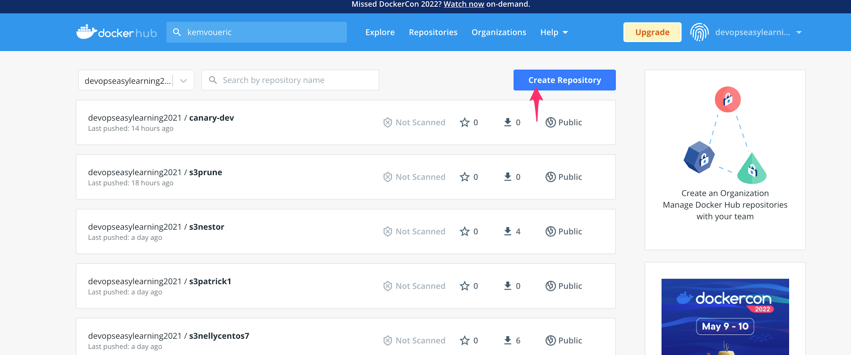
How to create a repository in dockerhub
1- login to dockerhub (you cannot create a repository if you are not login into an account, make sense right?
2- click on “create repository”
Damn
So simple right ?

Slide 84
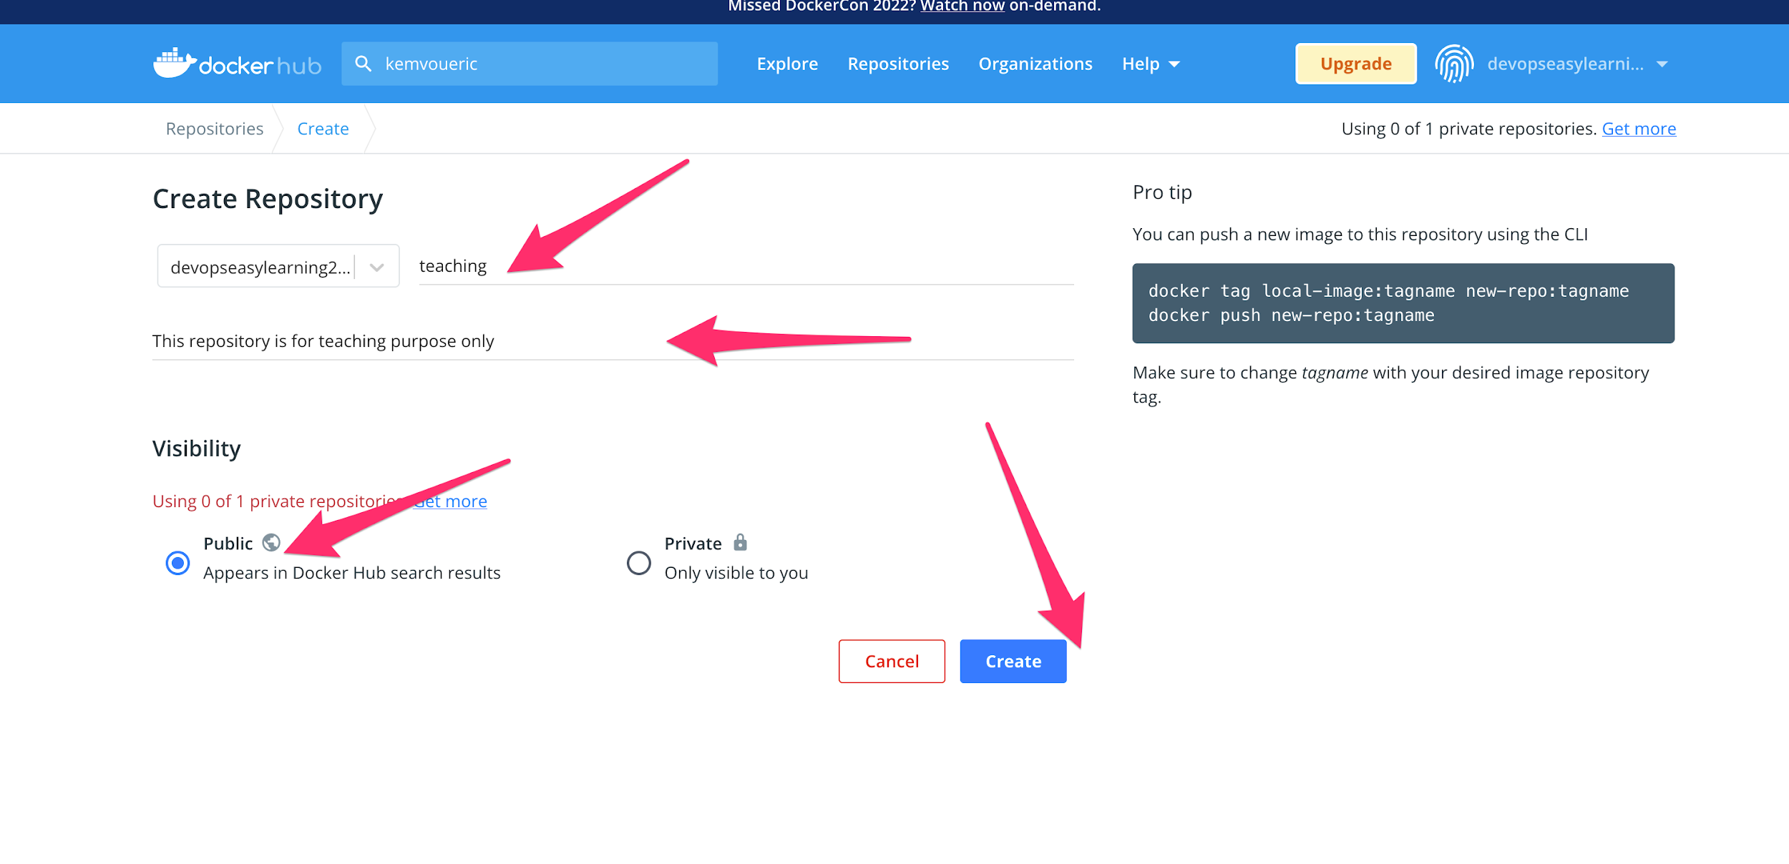
How to create a repository in dockerhub
3- enter repository name
4- enter a description (optional)
5- select public
6- select create
Damn
So simple right ?

Slide 85

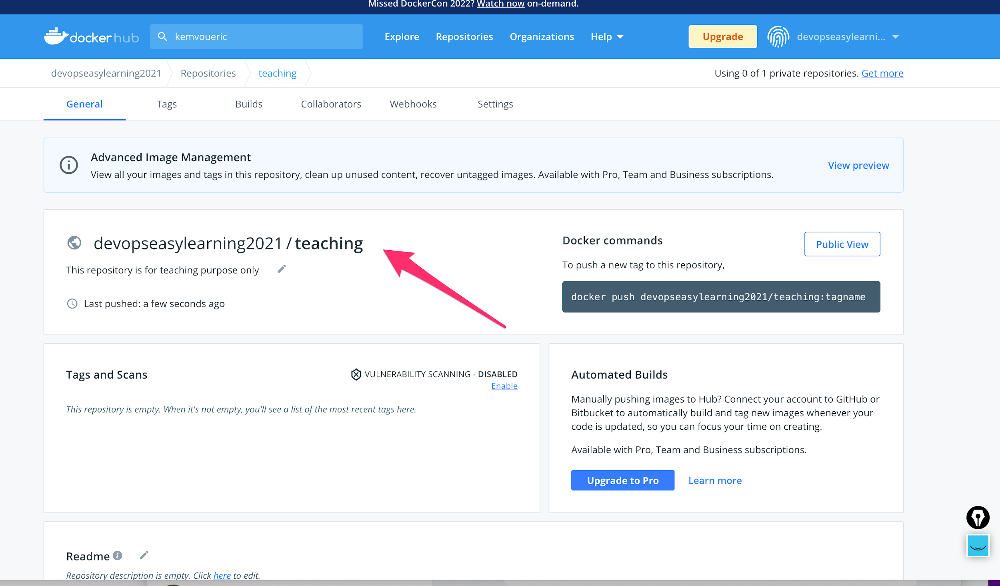
How to create a repository in dockerhub
Damn
So simple right ?

Slide 86
Hey check this out
Short and easy right ?
In the devops world time is money so people don’t have time to pronounce all words
Repository nickname is repo

Slide 87
What is a docker private repo
Short and easy right ?
In simple words private repo are repo that only authenticated user can modified or view

Slide 88
What is a docker public repo
Short and easy right ?
In simple words public repo are repo that everyone can view (pull, explore), but only authenticated users can modify (push)

Slide 89
Does official repositories public or private ?
Short and easy right ?
They are private repo but at the only exception that everyone can view, pull images from them

Slide 90
What does company used? Private or public repo
Short and easy right ?
They use private repository because they don’t people to have a hold of their image

Slide 91
Is docker free to use ?
Short and easy right ?
In docker all public repo are free, but there is a pull limit of 100 images every six hours
In docker private repo are not free docker will charge you for it.
GOOD NEWS docker offer one (1) free private repo per free account. It isn’t that beautiful?

Slide 92


How to push official image to dockerhub ?
Official images are maintained by certified and trusted companies as an individual you CAN’T push to an official repository
Interview trap question:
Can you push an image to an official repo?
I guess by now you know the answer
NO

Slide 93
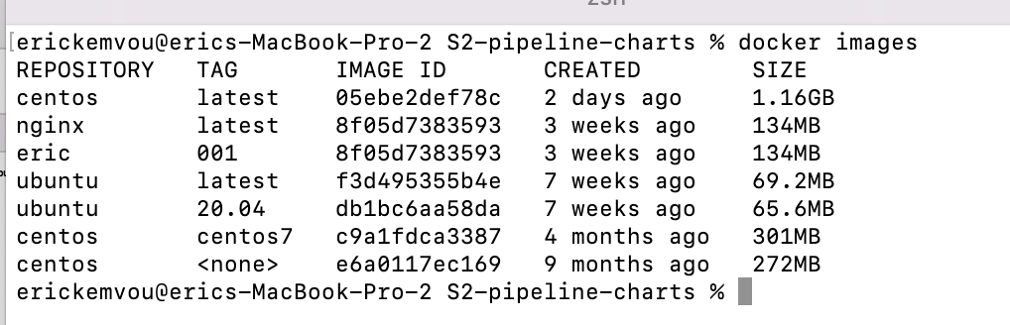
How to push NON official image to dockerhub ?
1- make sure the image you are trying to push has the correct structure (username of the account you will be pushing into if not you can tag it )
As you can see all my images are officials I can’t push them, so we have to tag correctly

Slide 94
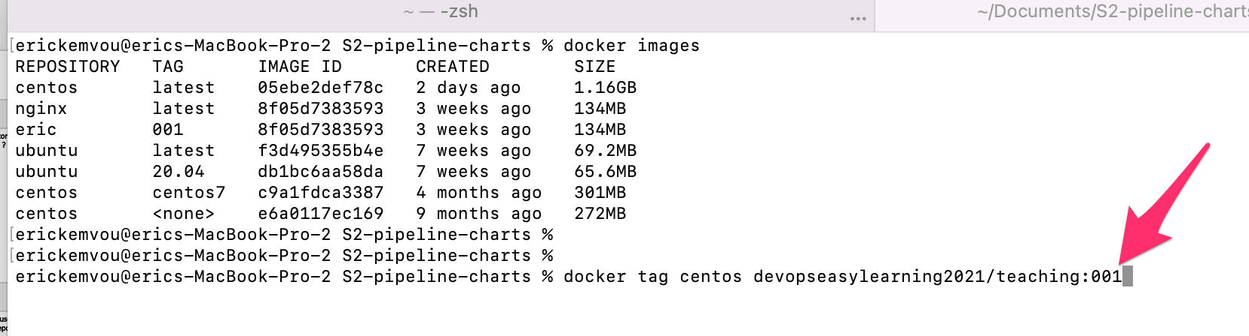
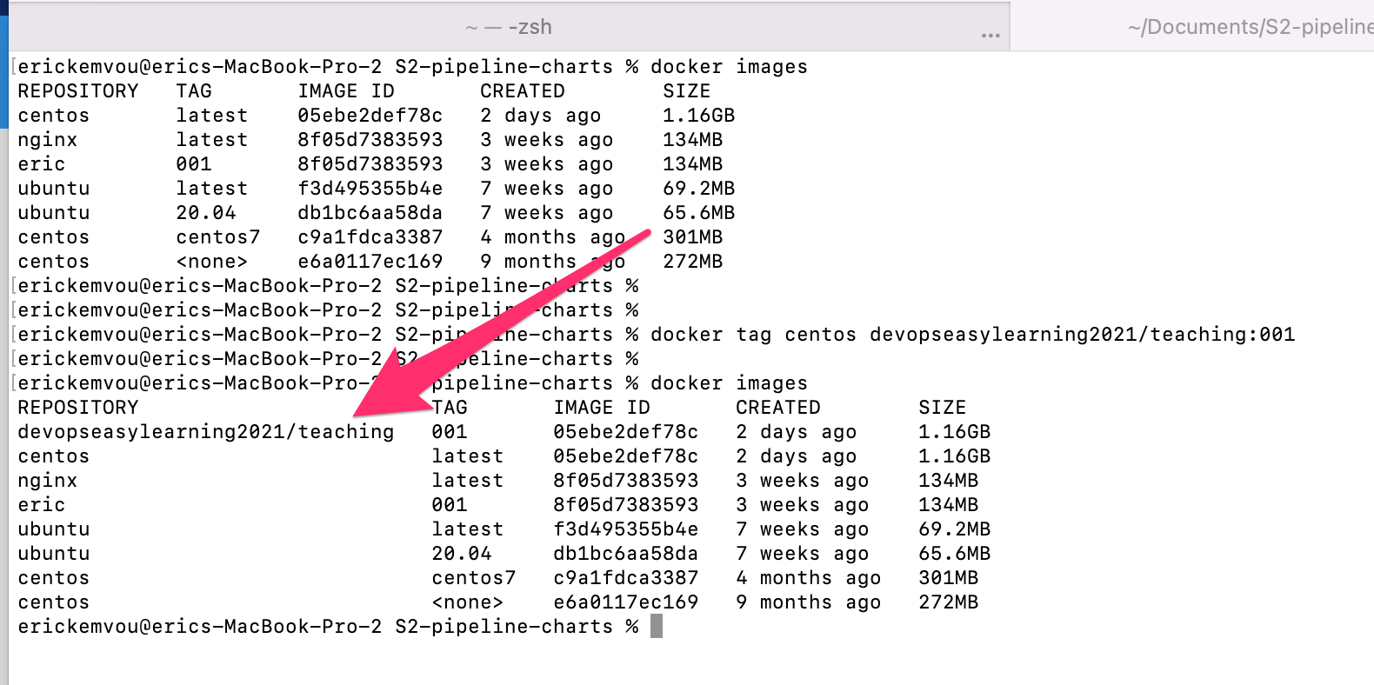
How to push NON official image to dockerhub ?

Slide 95
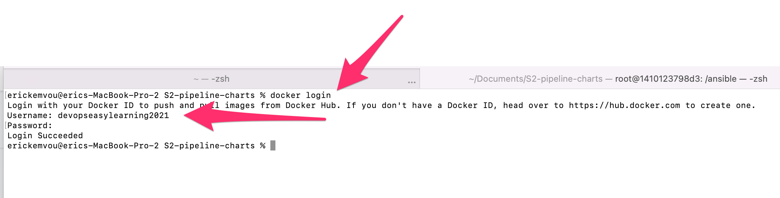
How to push NON official image to dockerhub ?
The password is hidden
2- login to dockerhub this time from our terminal
$ docker login

Slide 96
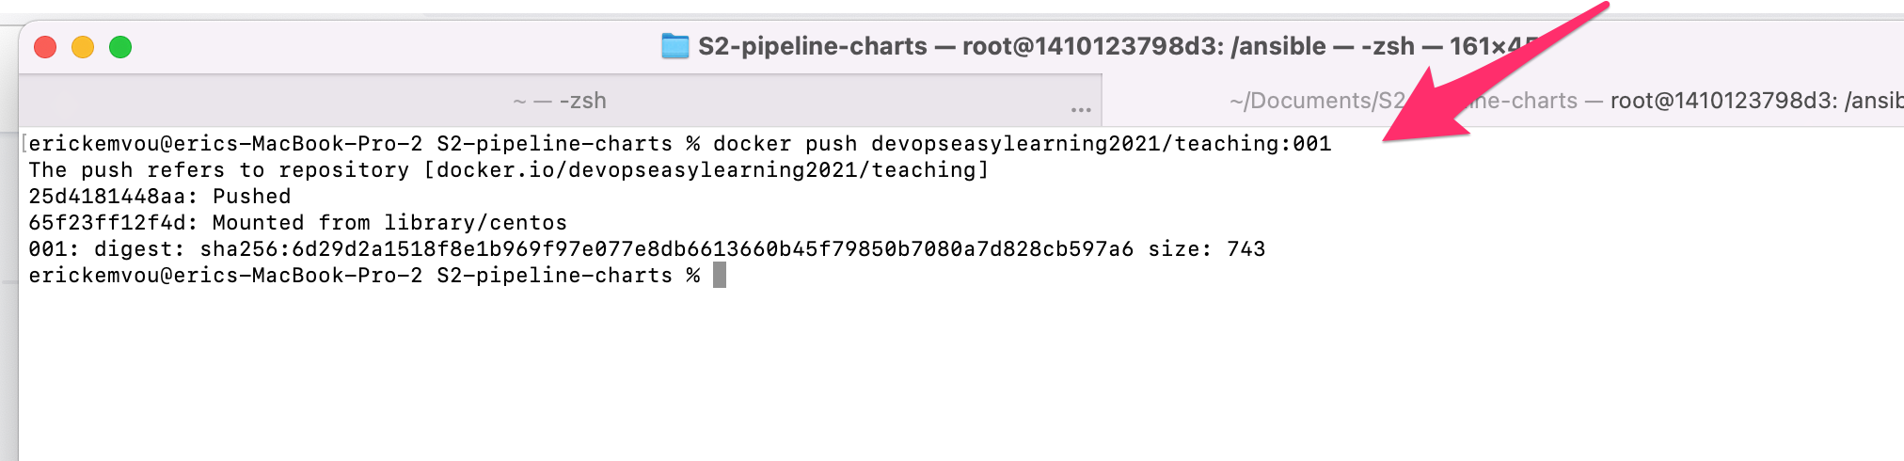
How to push NON official image to dockerhub ?
3- push to dockerhub
$ docker push [username]/[repository name]:[tag]
$ docker push devopseasylearning2021/teaching:001

Slide 97
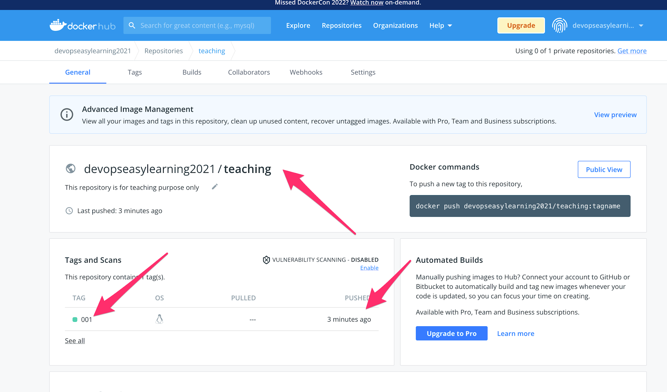
How to push NON official image to dockerhub ?
4- check dockerhub
$ docker push [username]/[repository name]:[tag]

Slide 98
NOTES
You don’t have to create a repository on dockerhub before you push an image into it, docker will automatically create the repository for you at push time if it does not exist

Slide 99

Why should I use other people image
I will build mine from scratch
Is it even possible ?

Slide 100
Dockerfile
What is a Dockerfile
How to create a Dockerfile
How to build an image

Slide 101
What is Dockerfile?
A Dockerfile is a script that automatically creates containers on the Docker platform. A Dockerfile is basically a text document that contains all the commands a user could call on the command line to assemble an image. The Docker platform runs natively on Linux and allows developers to build and run containers, self-contained applications or systems with no dependencies on the underlying infrastructure. Built upon the resource-isolation features of the Linux kernel, Docker helps developers and system administrators port applications across different systems and machines by running them inside containers.
Docker containers, created by Dockerfiles, can run on any Linux server. Container environments for applications are created using Docker images, which can be built either by executing commands manually or automatically through Dockerfiles. Linux and Windows programs can run inside Docker containers. Using Dockerfiles, developers can create an automated container build that executes several command-line instructions in succession, step by step. Docker containerization is essentially operating-system-level virtualization. Multiple independent containers may run within a single Linux instance without the startup overhead of virtual machines.
Dockerfiles enable greater flexibility and portability of business applications. IT organizations use Dockerfiles to package applications and their dependencies in a virtual container that can run on premises, in public or private clouds, or on bare metal. Such containers allow multiple applications, worker tasks and other processes to run autonomously on a single physical machine or across multiple virtual machines. Kubernetes is an open source system for automatically managing and orchestrating containerized applications created by Dockerfiles.

Slide 102

Dockerfile
The Default Dockerfile file know by docker is called Dockerfile.
what does it means by default it means that when you are using Dockerfile file as your default Dockerfile you don’t have to specify it to docker, but if you use any other file not with the same name you need to specify it to docker with the flag -f
Dockerfile and not dockerfile heyyyyyyy did see that? shine your no no mistake
docker build -t devopseasylearning/test:001 . # here docker will use the default Dockerfile since it has not been specified and if docker does not see a file called Dockerfile in your current repository docker will fault the command
docker build -f devopseasylearning/test:001 -f odilia_dockerfile . # here docker will use the dockerfile (odilia_dockerfile) provided

Slide 103
Dockerfile reference
Docker can build images automatically by reading the instructions from a Dockerfile. A Dockerfile is a text document that contains all the commands a user could call on the command line to assemble an image. Using docker build users can create an automated build that executes several command-line instructions in succession.
A Dockerfile is a text document (without a file extension) that contains the instructions to set up an environment for a Docker container. You can build a Docker image using a Dockerfile.

Slide 104
Dockerfile reference
How set the base Operating System of the image in Dockerfile ?
FROM and NOT from
FROM

Slide 105
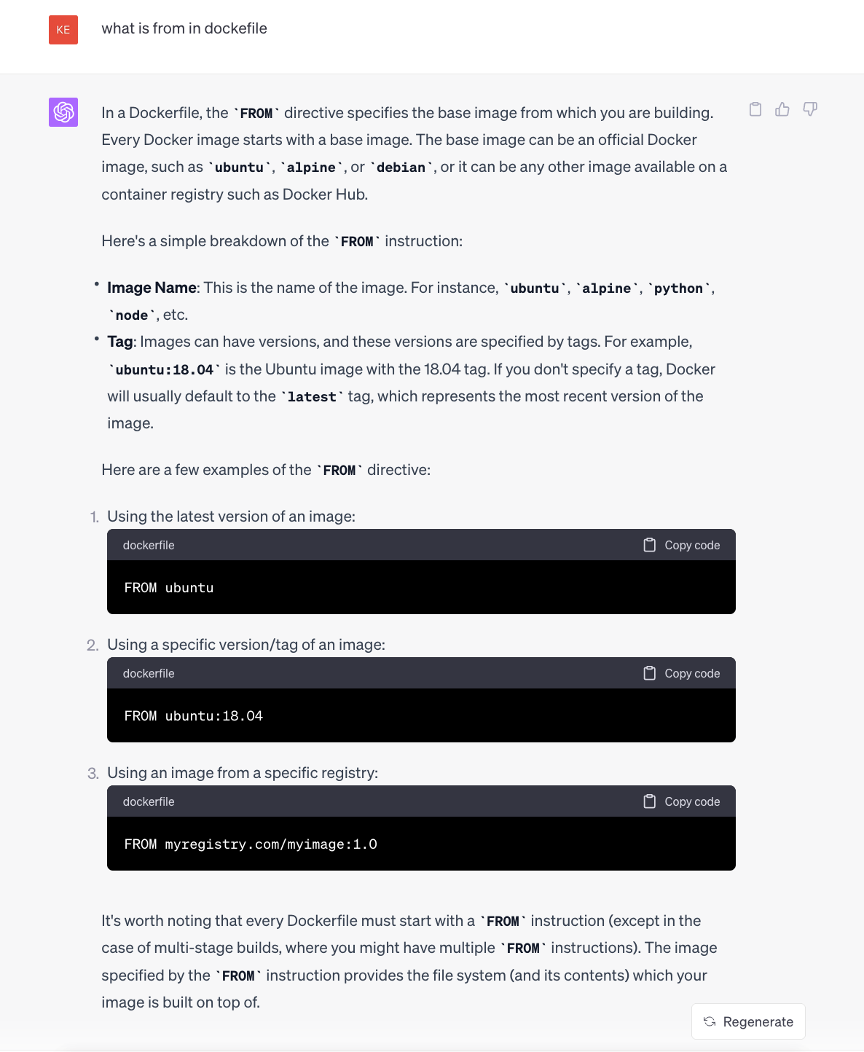
Dockerfile reference
FROM

Slide 106
Dockerfile reference
FROM
This help set the Operating system you want your image to have meaning the operating system your any container spinned with this docker image will have
FROM ubuntu:20.04 # meaning the OS of the image will be ubuntu 20.04
FROM centos # meaning the OS of the image will be centos
FROM alpine # meaning the OS of the image will be alpine
FROM redhat # meaning the OS of the image will be redhat

Slide 107
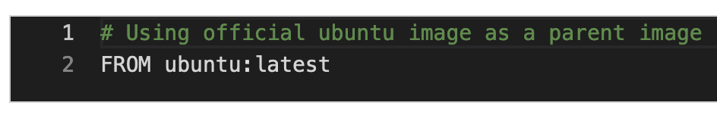
The Dockerfile explained line by line below
The FROM instruction tells docker which environment you would like to use
Most docker files start from a ‘parent’ image.
The parent image is added through the FROM keyword. Your image builds upon the parent image. We add the official Ubuntu image using. FROM ubuntu: latest.
It can be an official or non official image
Notice that from is in capital letter , in docker all instructions are in capital letter ( FROM RUN WORKDIR…etc)
FROM should always be the first line of a Dockerfile
So what happen when your write FROM ubuntu:20.04
Docker will start a container in the background a run all other instruction on it
$ FROM ubuntu:20.04
You can only have one FROM instruction is your Dockerfile
Well that is true to some extern (single stage image)
We will come back to it on class (multi stage image)

Slide 108
Dockerfile reference
How to add metadata in Dockerfile ?
LABEL and NOT label
LABEL

Slide 109
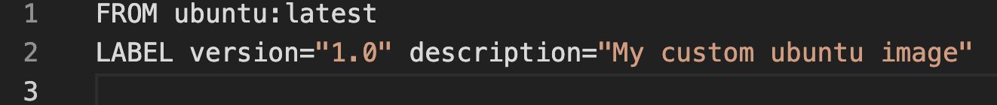

The Dockerfile explained line by line below
The LABEL instruction set metadata on the dockerfile mostly used to set information of the company or owner of the dockerfile.
PS: Don’t worry about this instruction I have never seen it on hundred of dockerfile we have at work
funny right ?
You can use multiple LABEL on the same Dockerfile

Slide 110
Dockerfile reference
How to run any command in Dockerfile ?
RUN and NOT run
RUN

Slide 111
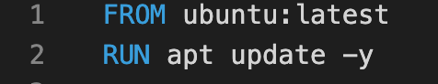
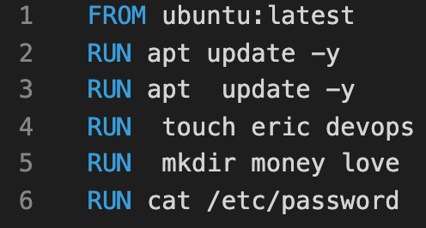
The Dockerfile explained line by line below
The RUN instruction tells docker that you want to run a linux command
You can have multiple RUN instructions on the same Dockerfile
Each time you want to run a linux command in Dockerfile you use RUN
Example
RUN apt update -y
RUN touch eric devops
RUN mkdir money love
RUN cat /etc/password
You can use multiple RUN on the same Dockerfile

Slide 112
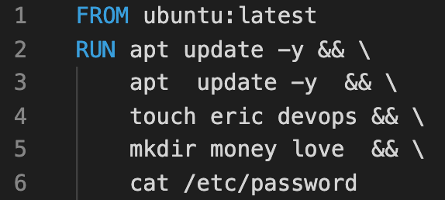
The Dockerfile explained line by line below
The RUN instruction tells docker that you want to run a linux command
You can have multiple RUN instructions on the same Dockerfile
But,
By best practice try as much as possible to combine them
We will explain why later on
&& allow you to run multiple command on a single line

Slide 113
The Dockerfile explained line by line below:
Let us build a Docker image so far.
We will come back on the Dockerfile

Slide 114

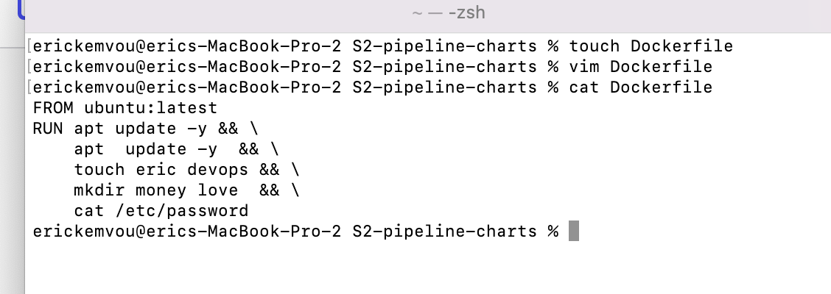
The Dockerfile explained line by line below:
All Dockerfile must start with capital D
$ touh Dockerfile
$ vim Dockerfile ( paste the contain below, save and quit)
FROM ubuntu:latest
RUN apt update -y && \
apt update -y && \
touch eric devops && \
mkdir money love && \
cat /etc/password

Slide 115
The Dockerfile explained line by line below:
Build a docker image
To build a docker image run the following command
$ docker build –t [ image name]:[tag] .
$ docker build –t test-image:001 .
The dot (.) at the end just tell docker that the build context is located in your current directory
Very important

Slide 116
Dockerfile reference
How to Indicates the port(s) the container will listen on at runtime in Dockerfile ?
EXPOSE and NOT expose
EXPOSE

Slide 117
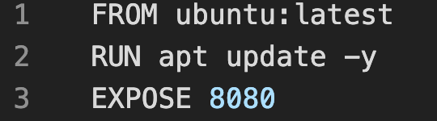
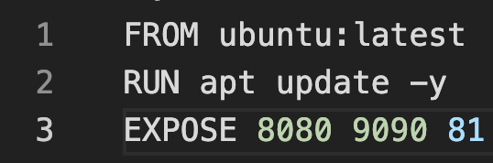
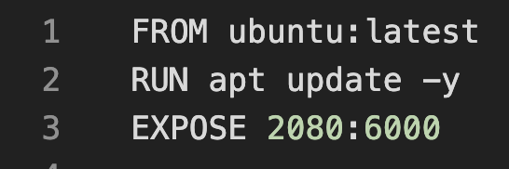
The Dockerfile explained line by line below
docker open a single port 8080
The EXPOSE instruction tells docker that you want open a port or multiple port so that end user can use it to access the application inside the container
docker open a multiple ports 8080 9090 and 81
You can use multiple EXPOSE on the same Dockerfile
docker open a range of port from 2080 to 6000

Slide 118
Dockerfile reference
How to Sets an environment variable inside the container in Dockerfile ?
ENV and NOT env
ENV

Slide 119
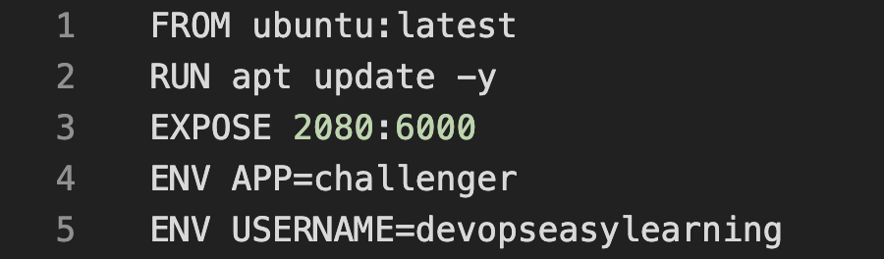
The Dockerfile explained line by line below
The ENV instruction tells docker that you want to create environment variable(s) inside the container so that it can be consumed at any given point of time by the application running inside
You can use multiple ENV on the same Dockerfile

Slide 120
Dockerfile reference
How to copy file from our current repository in Dockerfile ?
COPY and NOT copy
COPY

Slide 121
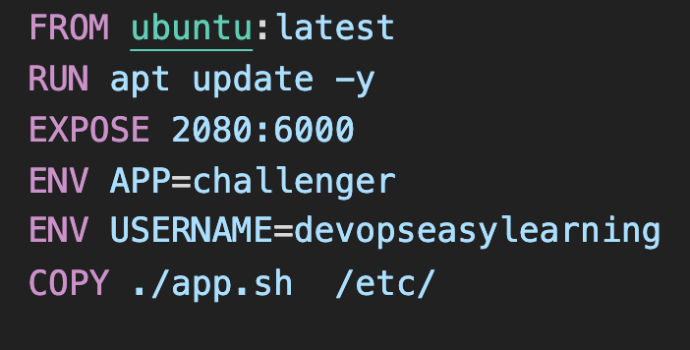
The Dockerfile explained line by line below
The COPY instruction Copies new files or directories from the source (virtual machine) to the container.
this is the source file that should exist on your virtual machine
this is the destination file where the file should be copied inside the container
You can use multiple COPY on the same Dockerfile

Slide 122
Dockerfile reference
How to copy file from our current repository in Dockerfile ?
ADD and NOT add
ADD

Slide 123
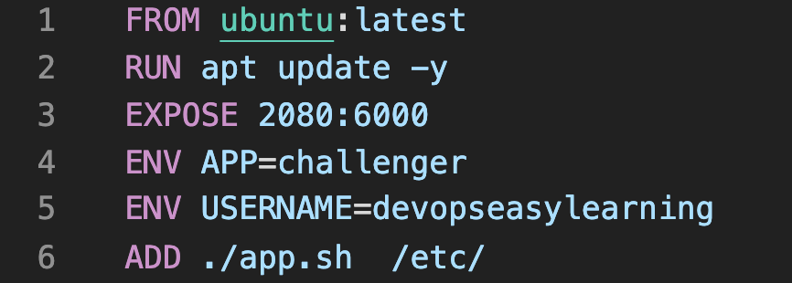
The Dockerfile explained line by line below
The ADD instruction Copies new files or directories from the source (virtual machine) to the container.
this is the source file that should exist on your virtual machine
this is the destination file where the file should be copied inside the container
You can use multiple ADD on the same Dockerfile

Slide 124
Dockerfile reference
How to copy file remotely in Dockerfile ?
ADD and NOT add
ADD

Slide 125
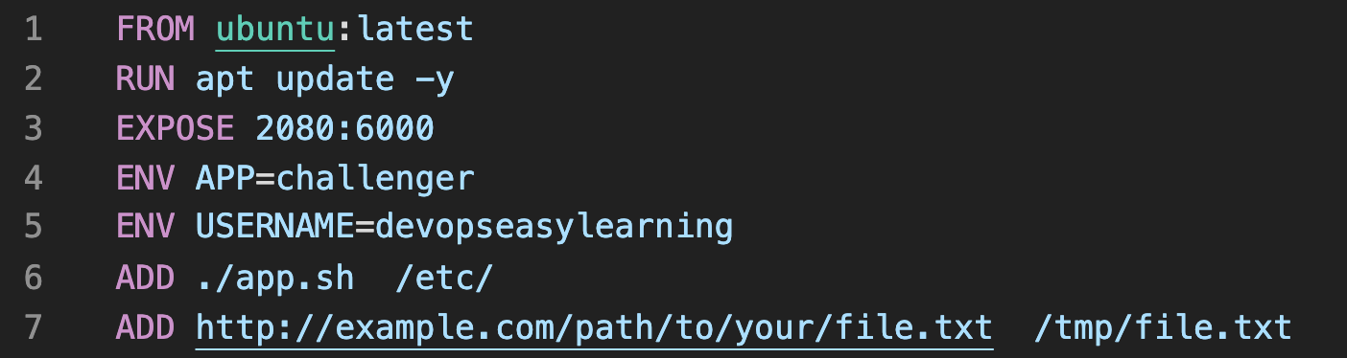
The Dockerfile explained line by line below
The ADD instruction Copies new files or directories from the source (virtual machine) to the container.
it also Copies new files, directories or remote file URLs to the filesystem of the container.
this is the remote source file
this is the destination file where the file should be copied inside the container
You can use multiple ADD on the same Dockerfile

Slide 126
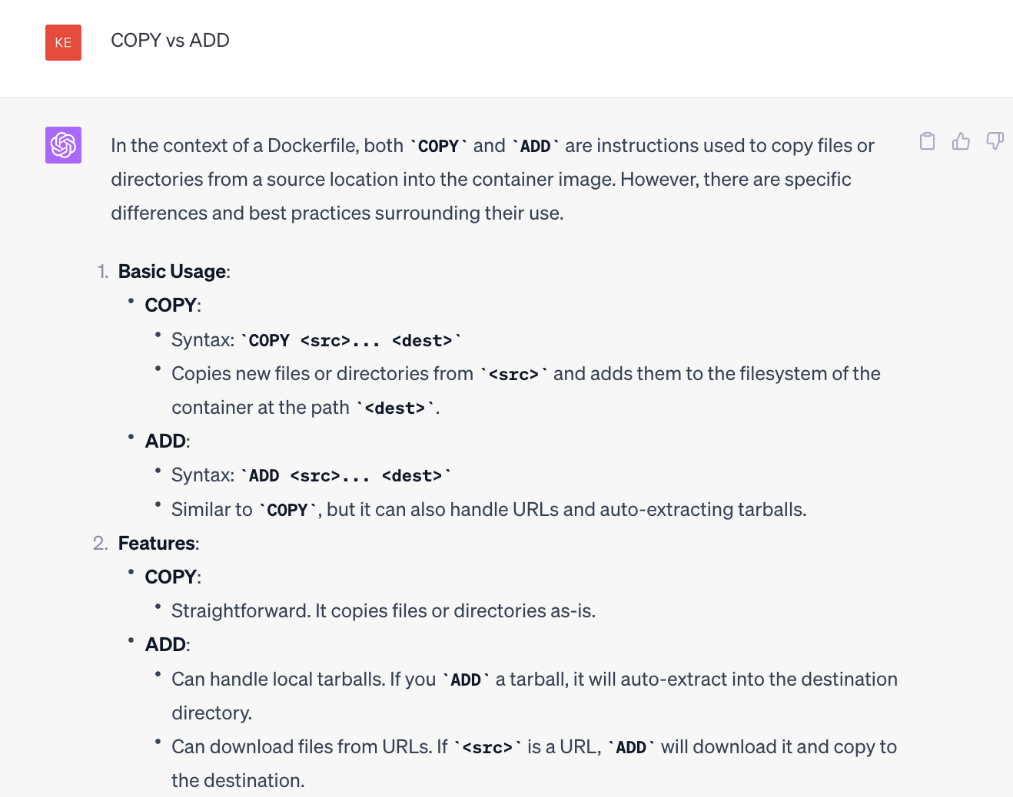
The Dockerfile explained line by line below

Slide 127
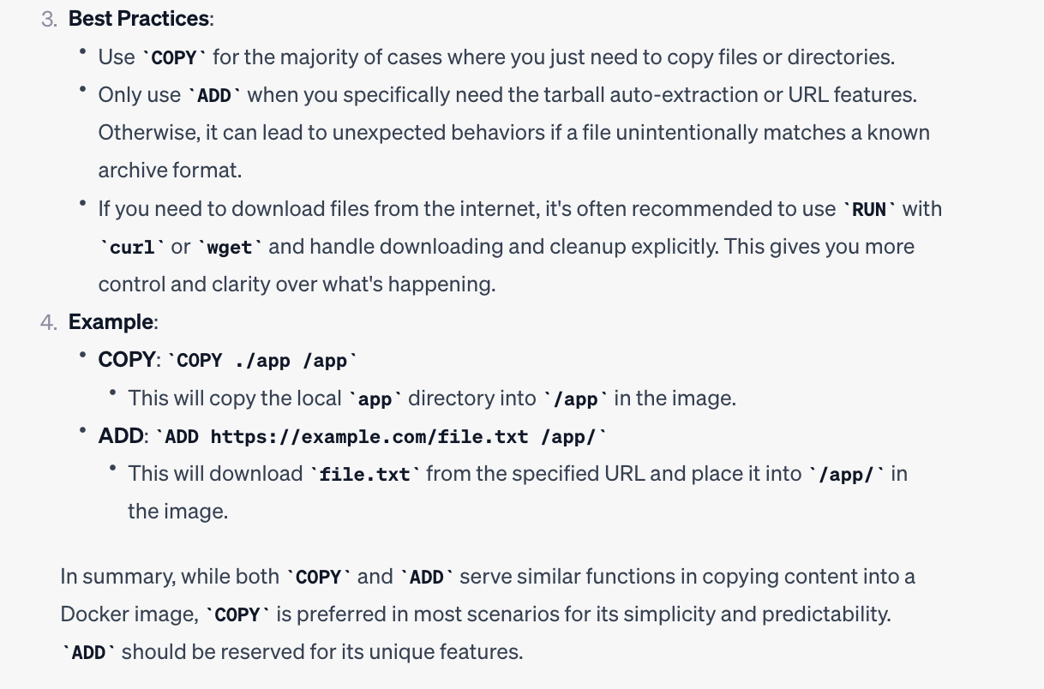
The Dockerfile explained line by line below

Slide 128
Dockerfile reference
How to set default or present working directory in Dockerfile ?
WORKDIR and NOT workdir
WORKDIR

Slide 129
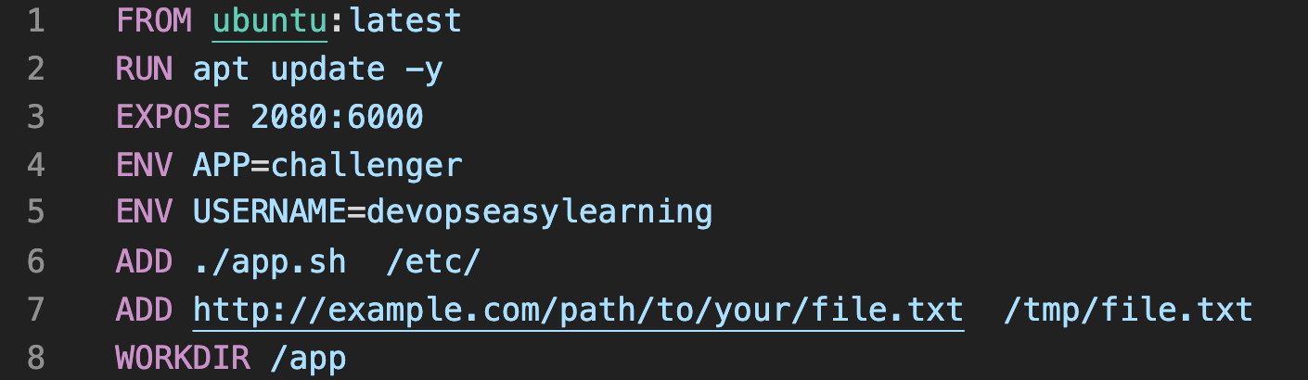
The Dockerfile explained line by line below
The WORKDIR instruction sets the working directory inside the container. If it doesn't exist, it will be created.
You can use multiple WORKDIR on the same Dockerfile but docker will only consider the last workdir

Slide 130
Dockerfile reference
How to create volume in Dockerfile ?
VOLUME and NOT volume
VOLUME

Slide 131
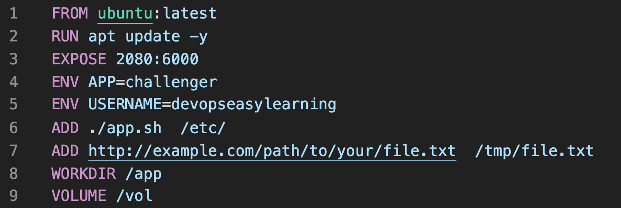
The Dockerfile explained line by line below
The VOLUME instruction creates a mount point with the specified name and marks it as holding externally mounted volumes from the native host or other containers.
You can use multiple VOLUME on the same Dockerfile

Slide 132
Dockerfile reference
How to set default user in Dockerfile ?
USER and NOT user
USER

Slide 133

The Dockerfile explained line by line below
The USER instruction help set the default user inside the container, by default the default user is root, but sometimes for security reason we don't want to use root also they are some application that can not run on user root
to set the user we can use a USER ID or name, also the user must exist first
USER 0 is root since root is th only user in linux have UID 0
You can use multiple USER on the same Dockerfile but docker will consider the last USER as the default USER

Slide 134

The Dockerfile explained line by line below
The USER instruction help set the default user inside the container, by default the default user is root, but sometimes for security reason we don't want to use root also they are some application that can not run on user root
to set the user we can use a USER ID or name, also the user must exist first
You can use multiple USER on the same Dockerfile but docker will consider the last USER as the default USER

Slide 135

The Dockerfile explained line by line below
The USER instruction help set the default user inside the container, by default the default user is root, but sometimes for security reason we don't want to use root also they are some application that can not run on user root
to set the user we can use a USER ID or name, also the user must exist first
You can use multiple USER on the same Dockerfile but docker will consider the last USER as the default USER
1001 is the default user ID for the first user created in linux , by the way in linux all user that are not root have their user ID above 1000

Slide 136
Dockerfile reference
How to create a variable that can be use at build time in Dockerfile ?
ARG and NOT arg
ARG

Slide 137

The Dockerfile explained line by line below
The ARG instruction Defines a variable that users can pass at build-time
You can use multiple ARG on the same Dockerfile
the $APP_VERSION will be replace with the value of ARG command at build time

Slide 138

Dockerfile reference

Slide 139

Dockerfile reference

Slide 140

Dockerfile reference

Slide 141
Dockerfile reference
How to set the first command that will be ran when the container start in Dockerfile ?
ENTRYPOINT and NOT entrypoint
ENTRYPOINT

Slide 142

The Dockerfile explained line by line below
The ENTRYPOINT instruction Defines the first command that will be ran when the container start
NOTICE THE BRACKETS so always remember to use brackets on ENTRYPOINT

Slide 143
Dockerfile reference
How to set the first command that will be ran when the container start in Dockerfile ?
CMD and NOT cmd
CMD

Slide 144

The Dockerfile explained line by line below
The CMD instruction Defines the first command that will be ran when the container start
You can use multiple CDM on the same Dockerfile but docker will use the last CMD as the first command to use when container start
NOTICE THE BRACKETS so always remember to use brackets on CMD

Slide 145
Dockerfile reference
Complementarity between ENTRYPOINT and CMD

Slide 146
Dockerfile reference

Slide 147

Dockerfile reference

Slide 148

Dockerfile reference

Slide 149

Dockerfile reference

Slide 150

Dockerfile reference

